Slide 1
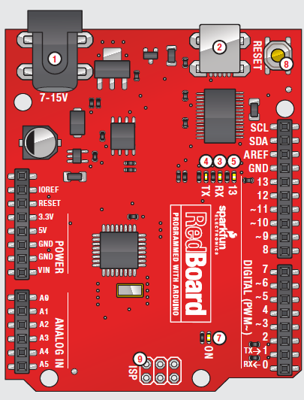
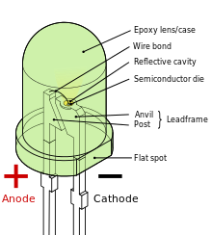
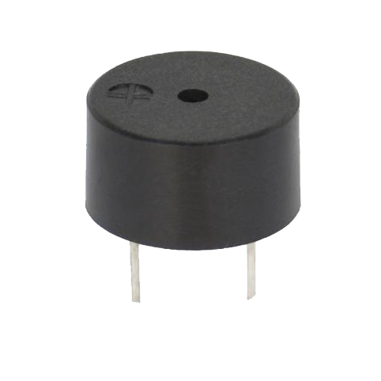
Programming Morse Code
Teens Engineer Birmingham

Slide 2
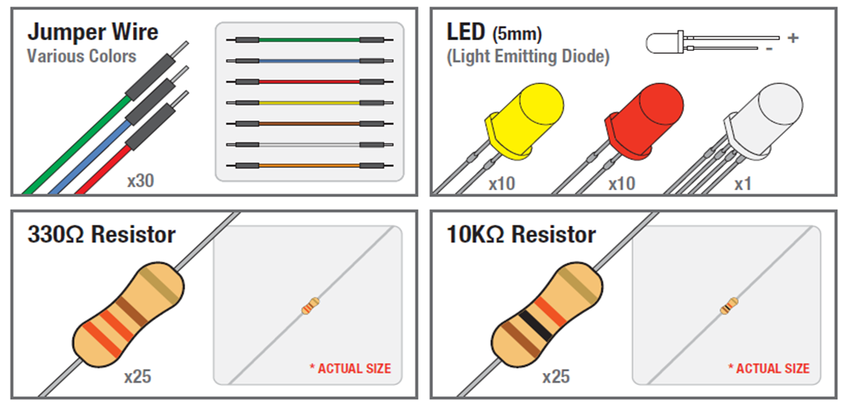
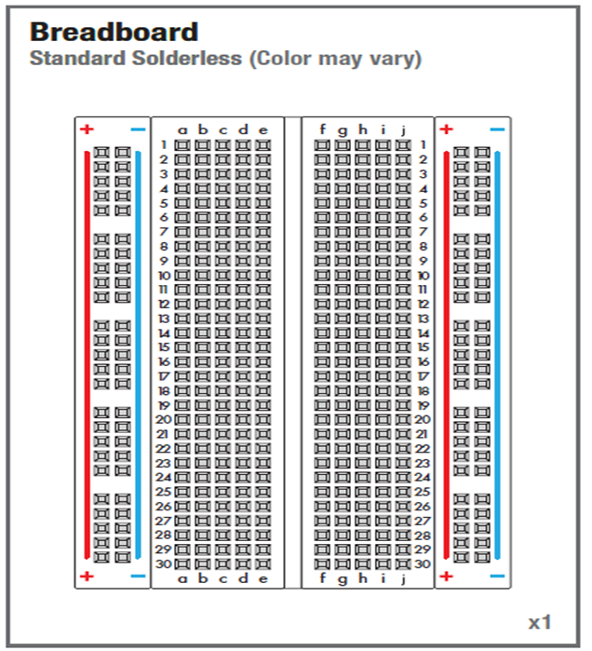
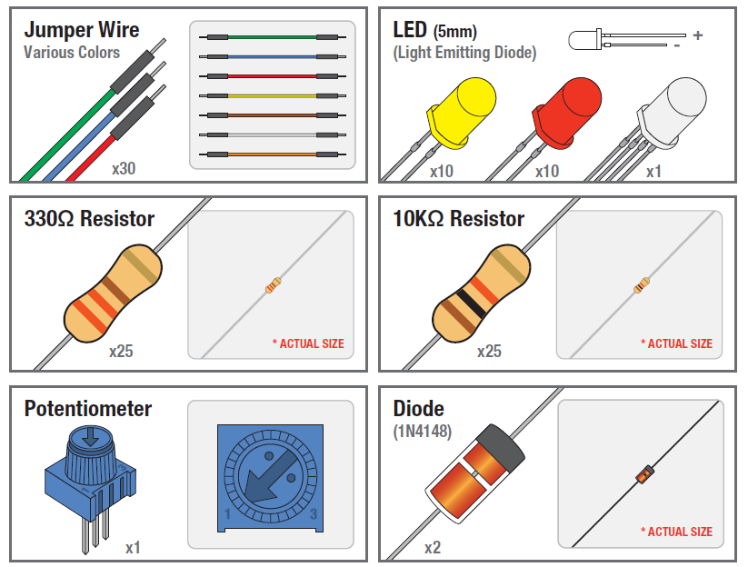
SIK Components

Slide 3
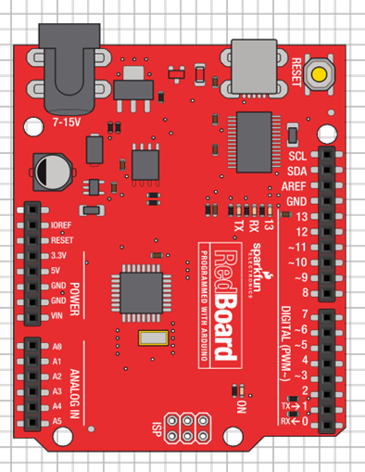


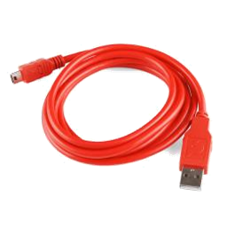
Make sure your board is unplugged!

Slide 4
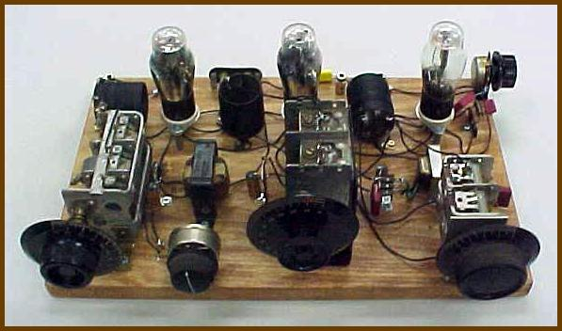
Modern Breadboard vs Old Breadboard Circuit

Slide 5
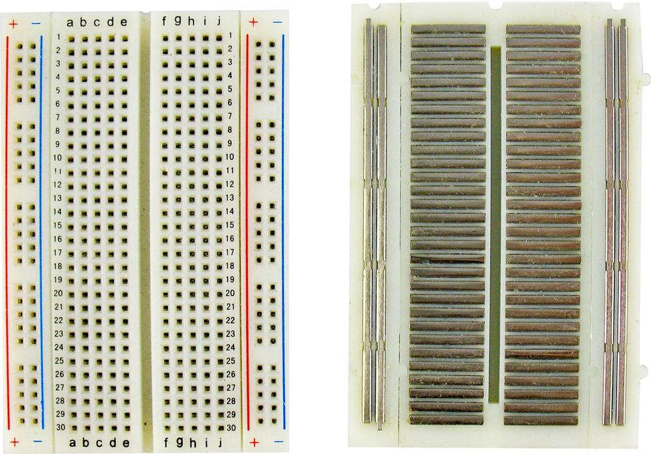
Breadboard
Front
Back

Slide 6
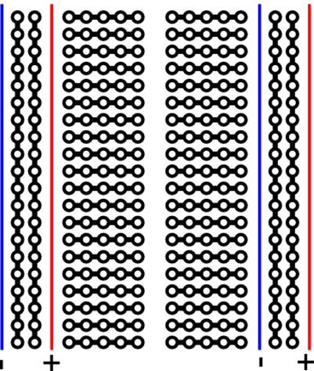
Modern Breadboard
Outside edges: pins are connected vertically
Inside rows: pins are connected horizontally with a break down the center

Slide 7
Try to connect 2 wires on the breadboard!

Slide 8
Arduino Microcontroller
USB
(to Computer)
PWR IN
RESET
A microcontroller is a physical device (HARDWARE)
POWER
5V / 3.3V / GND
Digital I\O
PWM(3, 5, 6, 9, 10, 11)
Analog INPUTS

Slide 9
Inputs and Outputs
Input: any signal going into the board.
Output: any signal exiting the board.

Slide 10
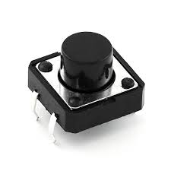
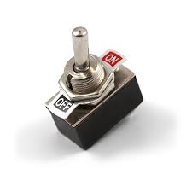
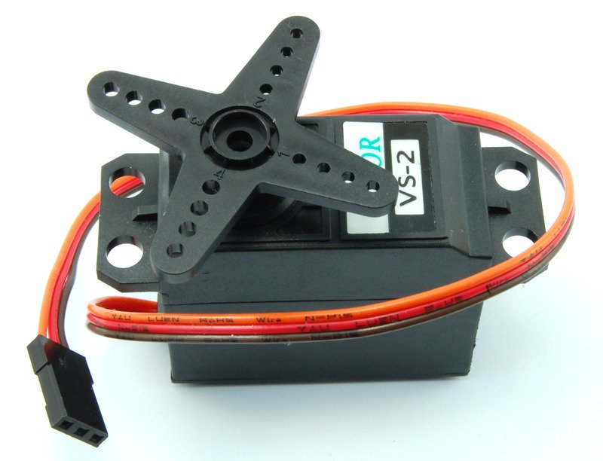
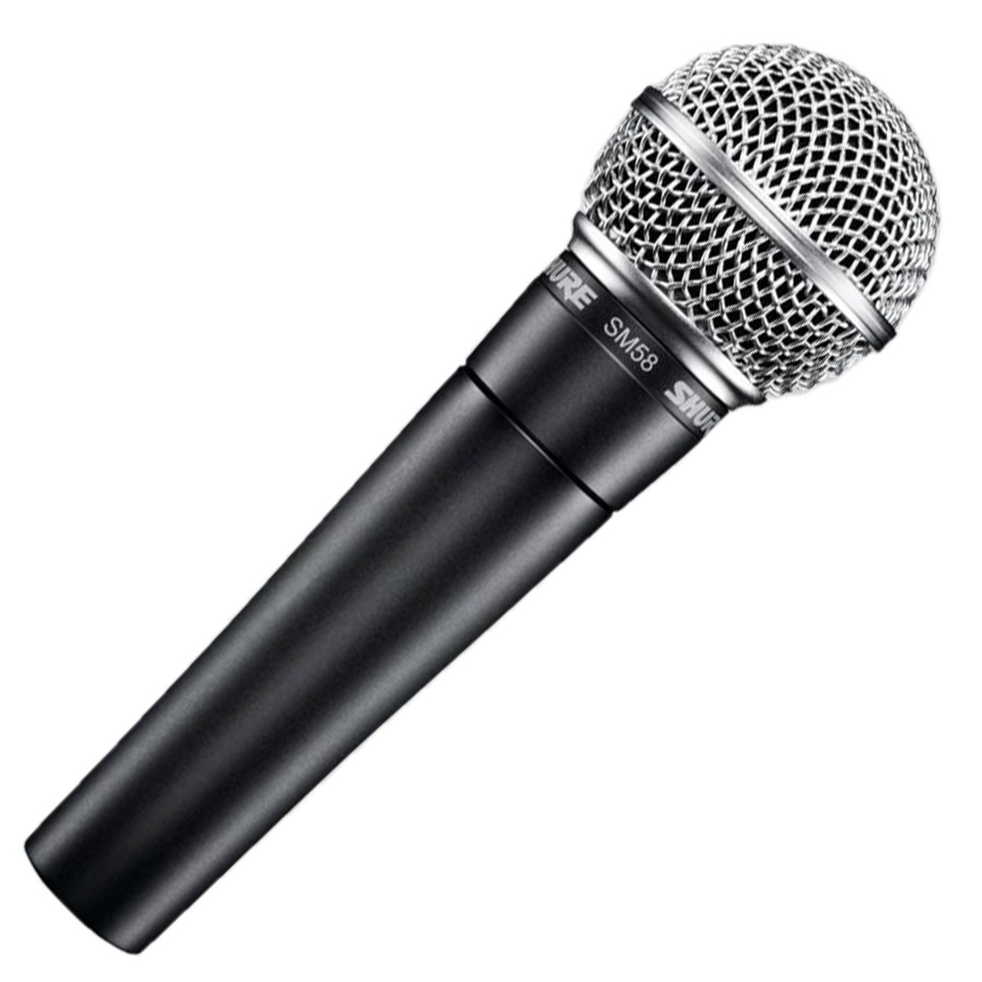
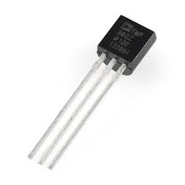
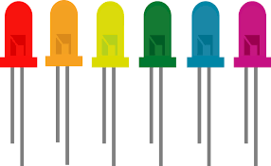
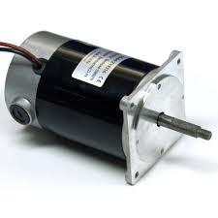
Inputs
Outputs
d
Notes:
Inputs: pushbutton, switch, infrared sensor/line follower, temperature sensor
Outputs: servo motor, piezo buzzer, LEDs, DC motor

Slide 11
Inputs
Outputs
d
Pushbutton
Switch
Servo Motor
Piezo Buzzer
Temperature Sensor
Microphone
LEDs
DC Motor
Notes:
Inputs: pushbutton, switch, infrared sensor/line follower, temperature sensor
Outputs: servo motor, piezo buzzer, LEDs, DC motor

Slide 12
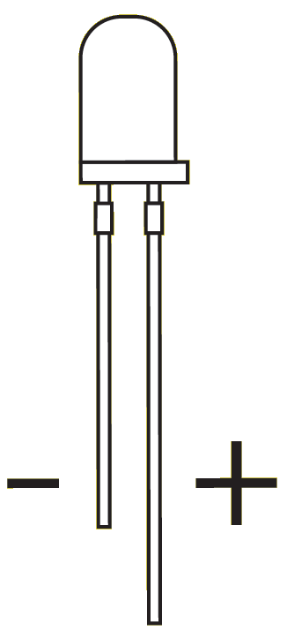
Light Emitting Diodes (LEDs)
The shorter side is negative
The longer side is positive

Slide 13
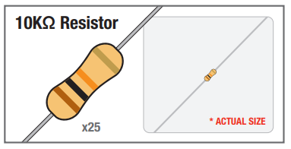
Resistors
Resistors are electrical components that resist electricity.
Resistors are used to reduce the amount of electricity in a circuit. We do this to avoid damaging certain components.
Measured in ohms or kiloohms (kohms)
Color of bands tells you how much resistance a resistor has

Slide 14
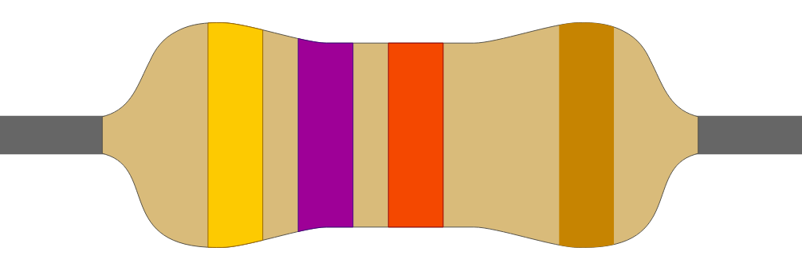
Find a resistor that looks like this one on your table

Slide 15
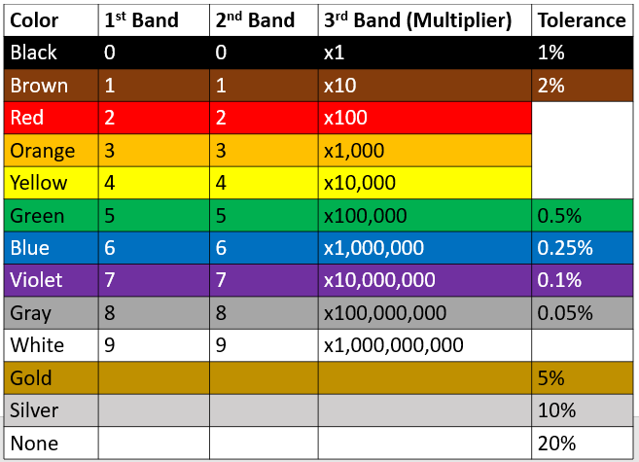
Resistor Color Code
Find the value of this resistor

Slide 16
Resistor Color Code
Orange | Orange | Brown | Gold

Slide 17
Resistor Color Code
Orange | Orange | Brown | Gold
3

Slide 18
Resistor Color Code
Orange | Orange | Brown | Gold
3 | 3

Slide 19
Resistor Color Code
Orange | Orange | Brown | Gold
3 | 3 | x10

Slide 20
Resistor Color Code
Orange | Orange | Brown | Gold
3 | 3 | x10 | 5% tolerance

Slide 21
Resistor Color Code
Orange | Orange | Brown | Gold
3 | 3 | x10 | 5% tolerance
33 x 10
330 ohm or 330 ohm resistor

Slide 22
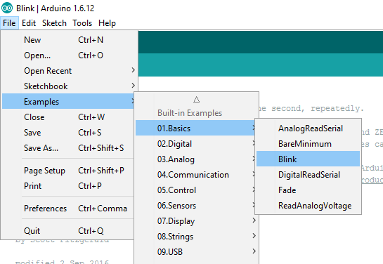

Open Blink example in Arduino

Slide 23
Testing the LED with a constant power supply

Slide 24
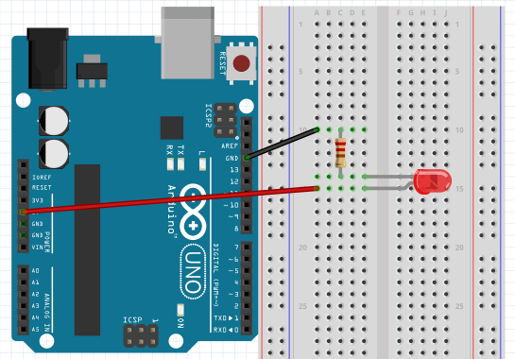
LED Circuit
1
5
Negative Side
GND
10
15
5V
Positive Side
20
25

Slide 25
Programming the LED to blink using a Digital Input/Output (DIO) pin

Slide 26
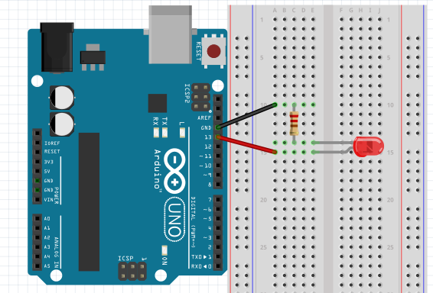
Change the Power Source From 5V to Pin 13
Negative Side
GND
Change 5V to Pin 13
Positive Side

Slide 27
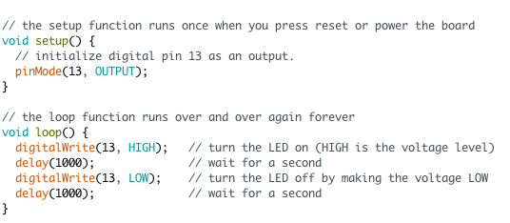
Blink
*read comments for hints*

Slide 28
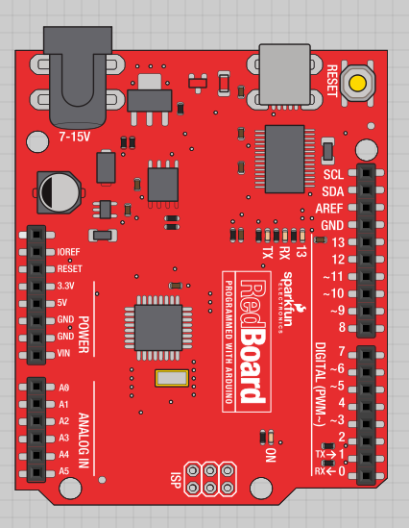
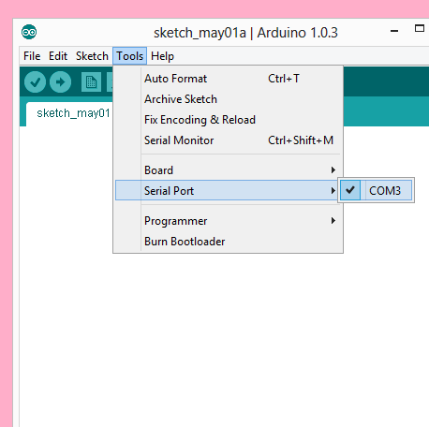
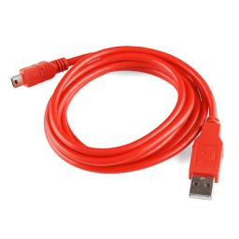
Plug in your board and select the serial port

Slide 29
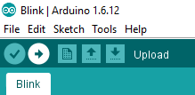
Upload your code to the board
Click here to upload

Slide 30
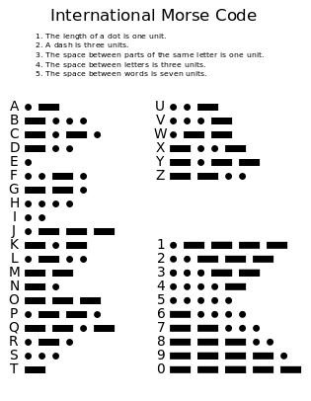
International Morse Code
Dot = 1 unit
Dash = 3 units
Space between parts of same letter = 1 unit
Space between letters = 3 units
Space between words = 7 units
Notes:
Write your name using morse code!

Slide 31
Morse Code: Letter S
Dot = 1 unit
Dash = 3 units
Space between parts of same letter = 1 unit
Space between letters = 3 units
Space between words = 7 units
LED Action
ON
OFF
ON
OFF
ON
OFF
S:
{
{
{
Delay
1 unit
1 unit
1 unit
1 unit
1 unit
3
units

Slide 32
Morse Code: Letter O
Dot = 1 unit
Dash = 3 units
Space between parts of same letter = 1 unit
Space between letters = 3 units
Space between words = 7 units
LED Action
ON
OFF
ON
OFF
ON
OFF
O:
{
{
{
Delay
3 units
1 unit
3 units
1 unit
3 units
3
units

Slide 33
Morse Code: Letter S
Dot = 1 unit
Dash = 3 units
Space between parts of same letter = 1 unit
Space between letters = 3 units
Space between words = 7 units
LED Action
ON
OFF
ON
OFF
ON
OFF
S:
{
{
{
Delay
1 unit
1 unit
1 unit
1 unit
1 unit
7
units

Slide 34
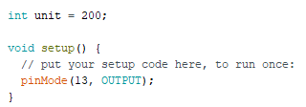
Morse Code LED: SOS
(Part 1/2)
Dot = 1 unit
Dash = 3 units
Space between parts of same letter = 1 unit
Space between letters = 3 units
Space between words = 7 units

Slide 35
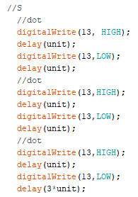
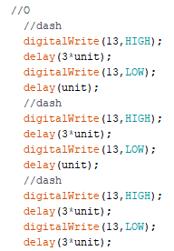
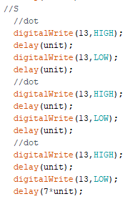
Morse Code LED: SOS (Part 2/2)

Slide 36
Blink an LED to spell your name in Morse Code!

Slide 37
International Morse Code
Dot = 1 unit
Dash = 3 units
Space between parts of same letter = 1 unit
Space between letters = 3 units
Space between words = 7 units
Notes:
Write your name in morse code by flashing the LED!

Slide 38
Morse Code With Buzzer
Same idea as the LED, just turn the buzzer on and off instead!

Slide 39
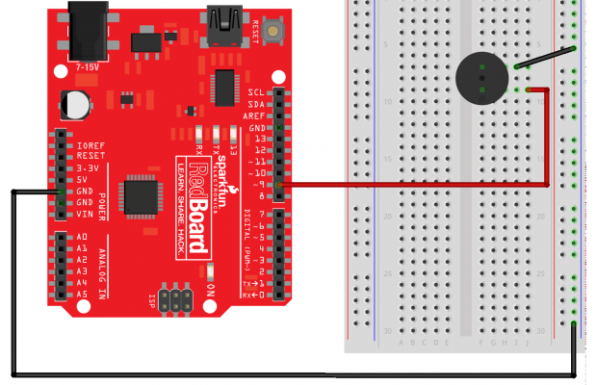
Piezo Buzzer Circuit

Slide 40
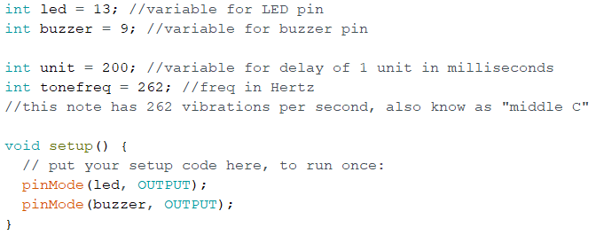
Morse Code Buzzer and LED -Update Your Variables

Slide 41
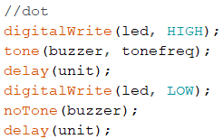
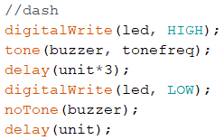
Morse Code With Buzzer and LED

Slide 42
M
o
r
s
e
C
o
d
e
S
O
S

Slide 43
Add the buzzer to your existing code spelling your name in Morse Code!

Slide 44
International Morse Code
Dot = 1 unit
Dash = 3 units
Space between parts of same letter = 1 unit
Space between letters = 3 units
Space between words = 7 units
Notes:
Combine your code to write your name in morse code using both the buzzer and the LED!

Slide 45
Questions?
Thank you!

Slide 46
Supplementary Material

Slide 47
Arduino Reference Links
void
setup
pinMode
loop
digitalWrite
delay
tone
noTone

Slide 48

Variables
Variables are used to store information. They have a name and a value and can be used throughout the code.
redLED is the name
13 is the value, in this case it’s a pin on the board
13
redLED

Slide 49
Command: pinMode
Pin # on the board
Pin # can be a variable if it was declared at the beginning of the program
Configures the pin as an INPUT or an OUTPUT

Slide 50
Command: digitalWrite
Pin # (or variable for pin #)
Turns the power to the pin on and off.
HIGH = on
LOW = off

Slide 51
Command: delay
Delays pause the program for a specified time, the time is in milliseconds.
1 second = 1000 milliseconds
What is the delay for these?
1000 ms delay

